Slide 2
Watch a video and write the names of leisure activities

Slide 3
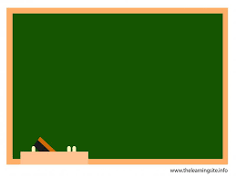
Unit
1
LEISURE TIME
LESSON 4: COMMUNICATION
EVERYDAY ENGLISH

Slide 4
Answer the questions:
1. What do you like doing in your free time?
2. What do young people in Viet Nam often do in their free time?
surfing the net
listening to music
……………

Slide 5
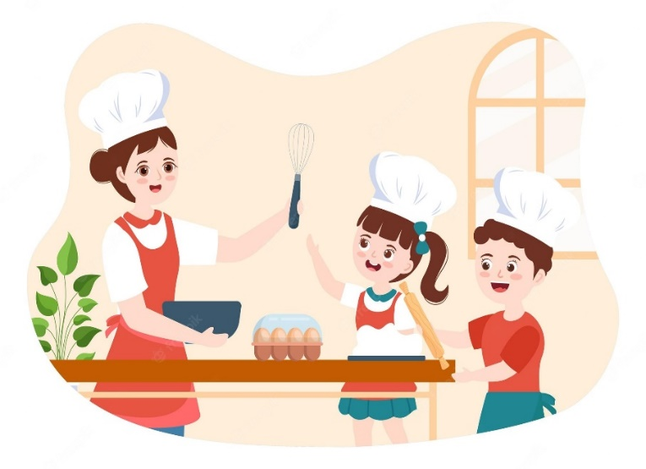
1
Listen and read the conversations. Pay attention to the highlighted sentences.
Trang: Would you like to go to the cooking club with me this Sunday?
Ann: I’d love to. Thanks.
1
Tom: Do you fancy going for a walk?
Mark: That’s great. Thanks.
2
* Structures
How to invite | How to accept invitations
- Would you like + to V? - Do you fancy + Ving? | - I'd love to. Thanks. - That's great. Thanks

Slide 6
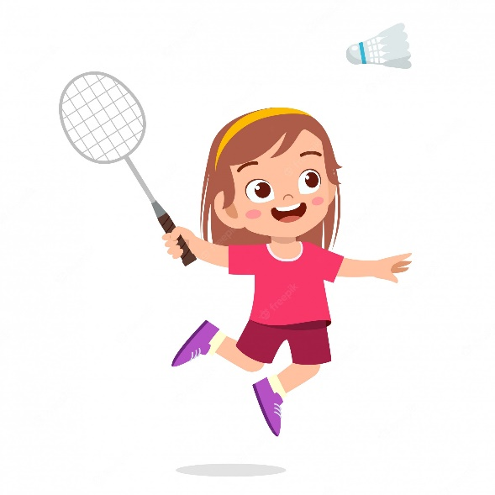
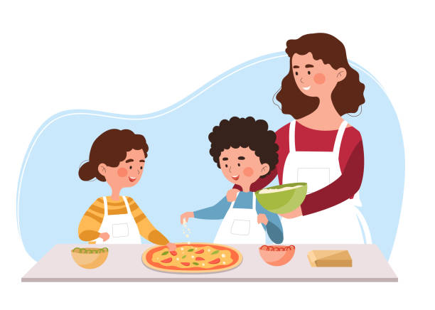
2
Work in pairs. Practise inviting and accepting invitations in the following situations. Remember to use the highlighted language in 1.
You invite your friend to play badminton.
You invite your friend to make paper flowers with you.
You invite your friend to try your home-made pizza.

Slide 7
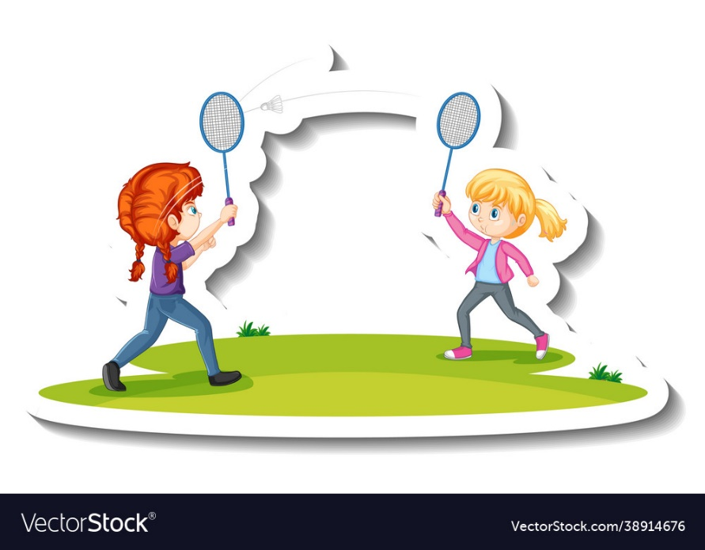
2
Work in pairs. Practise inviting and accepting invitations in the following situations. Remember to use the highlighted language in 1.
* You invite your friend to play badminton.
A: Would you like to play badminton with me this Sunday afternoon?
B: I'd love to. Thanks.

Slide 8
2
Work in pairs. Practise inviting and accepting invitations in the following situations. Remember to use the highlighted language in 1.
* You invite your friend to make paper flowers with you.
Tom: Do you fancy making paper flowers with me?
Linh: That's great. Thanks.

Slide 9
2
Work in pairs. Practise inviting and accepting invitations in the following situations. Remember to use the highlighted language in 1.
* You invite your friend to try your home-made pizza.
Huy: Would you like to try my home-made pizza?
Huong: I'd love to. Thanks.

Slide 10
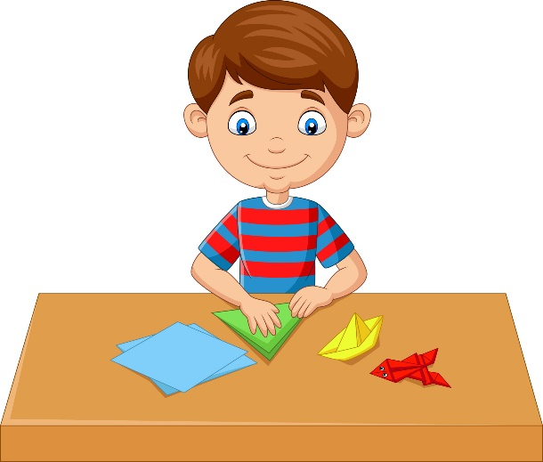
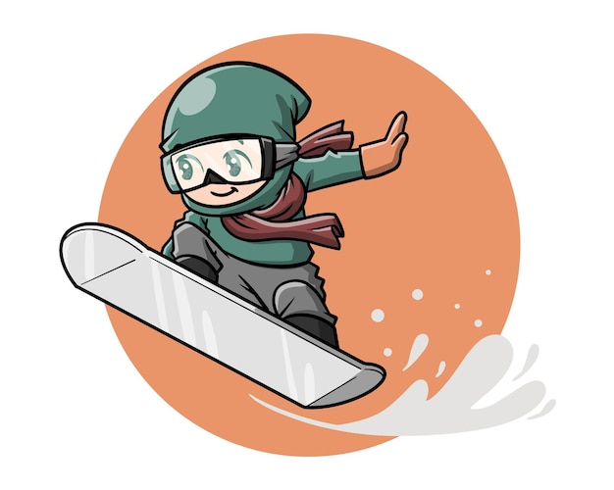
Teens’ leisure activities around the world
3
Work in pairs. Answer the question.
What is the activity in each picture?
doing origami
playing badminton
snowboarding

Slide 11
4
Read what three teenagers say about their leisure activities. Complete the table with the information from the text.
Sakura (Kyoto, Japan): Origami is the art of paper folding. I love doing it on my own in my free time. With just some sheets of paper, I can create almost anything: flowers, birds, or fans. Doing origami helps me to relax.
Eric (St. Gallen, Switzerland): My hometown has some famous ski resorts. I'm into snowboarding and usually go to a nearby ski resort with my parents at weekends. Snowboarding improves my overall health and balance.
Lan (Quang Binh, Viet Nam): I'm keen on playing sport, especially badminton. My best friend lives next door, so we play badminton almost every afternoon. It’s an easy sport, and it also improves my muscle strength and helps reduce stress.

Slide 12
4
Read what three teenagers say about their leisure activities. Complete the table with the information from the text.
Name | Country | Leisure activity | Person / People to do the activity with | Benefits of the activity
Sakura | Japan
Eric | Switzerland
Lan | Viet Nam
doing origami
no one
helps her to relax
snowboarding
parents
improves his overall health and balance
playing badminton
- improves her muscle strength
- reduces stress
best friend

Slide 13
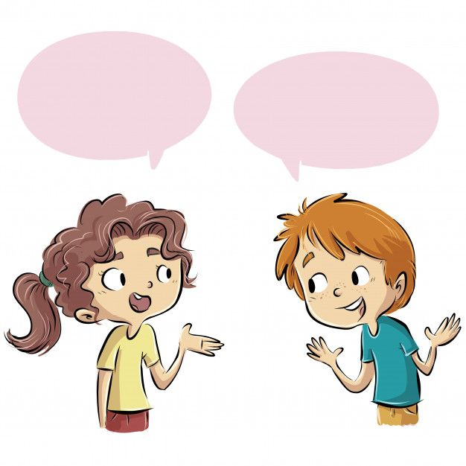
5
Work in groups. Ask and answer the questions.
Which of the activities in 4 do you want to try?
Why do you want to try it?
- I want to try playing badminton because it’s easy.
- I want to try snowboarding. It seems fun and adventurous. it also helps improve my heath and balance.

Slide 14
* CONSOLIDATION
What have we learnt in this lesson?
How to invite and accept invitations

Slide 15
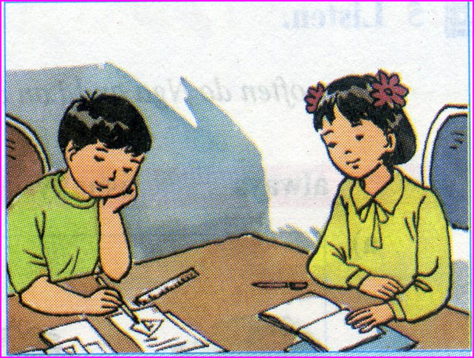
homework
- Do exercises in the workbook.
- Prepare lesson 5 ( skills 1)

